Slide 1
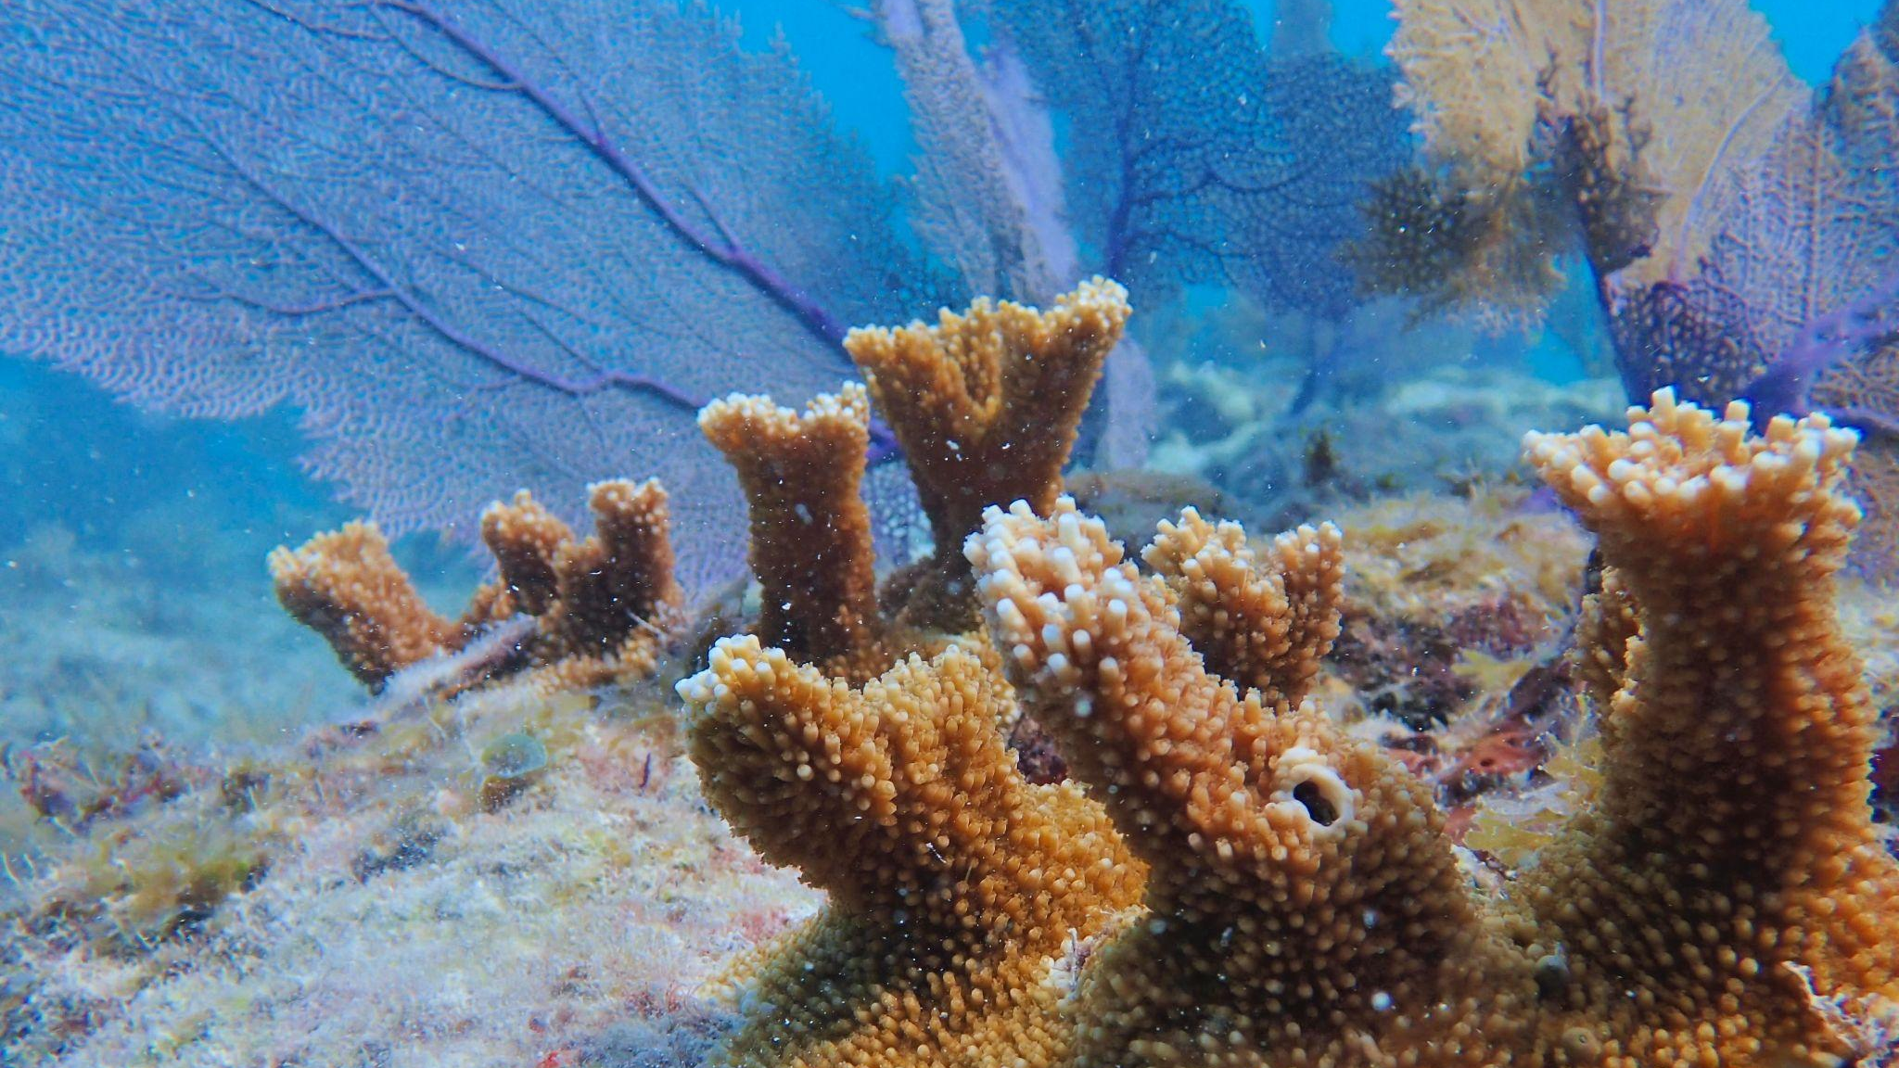
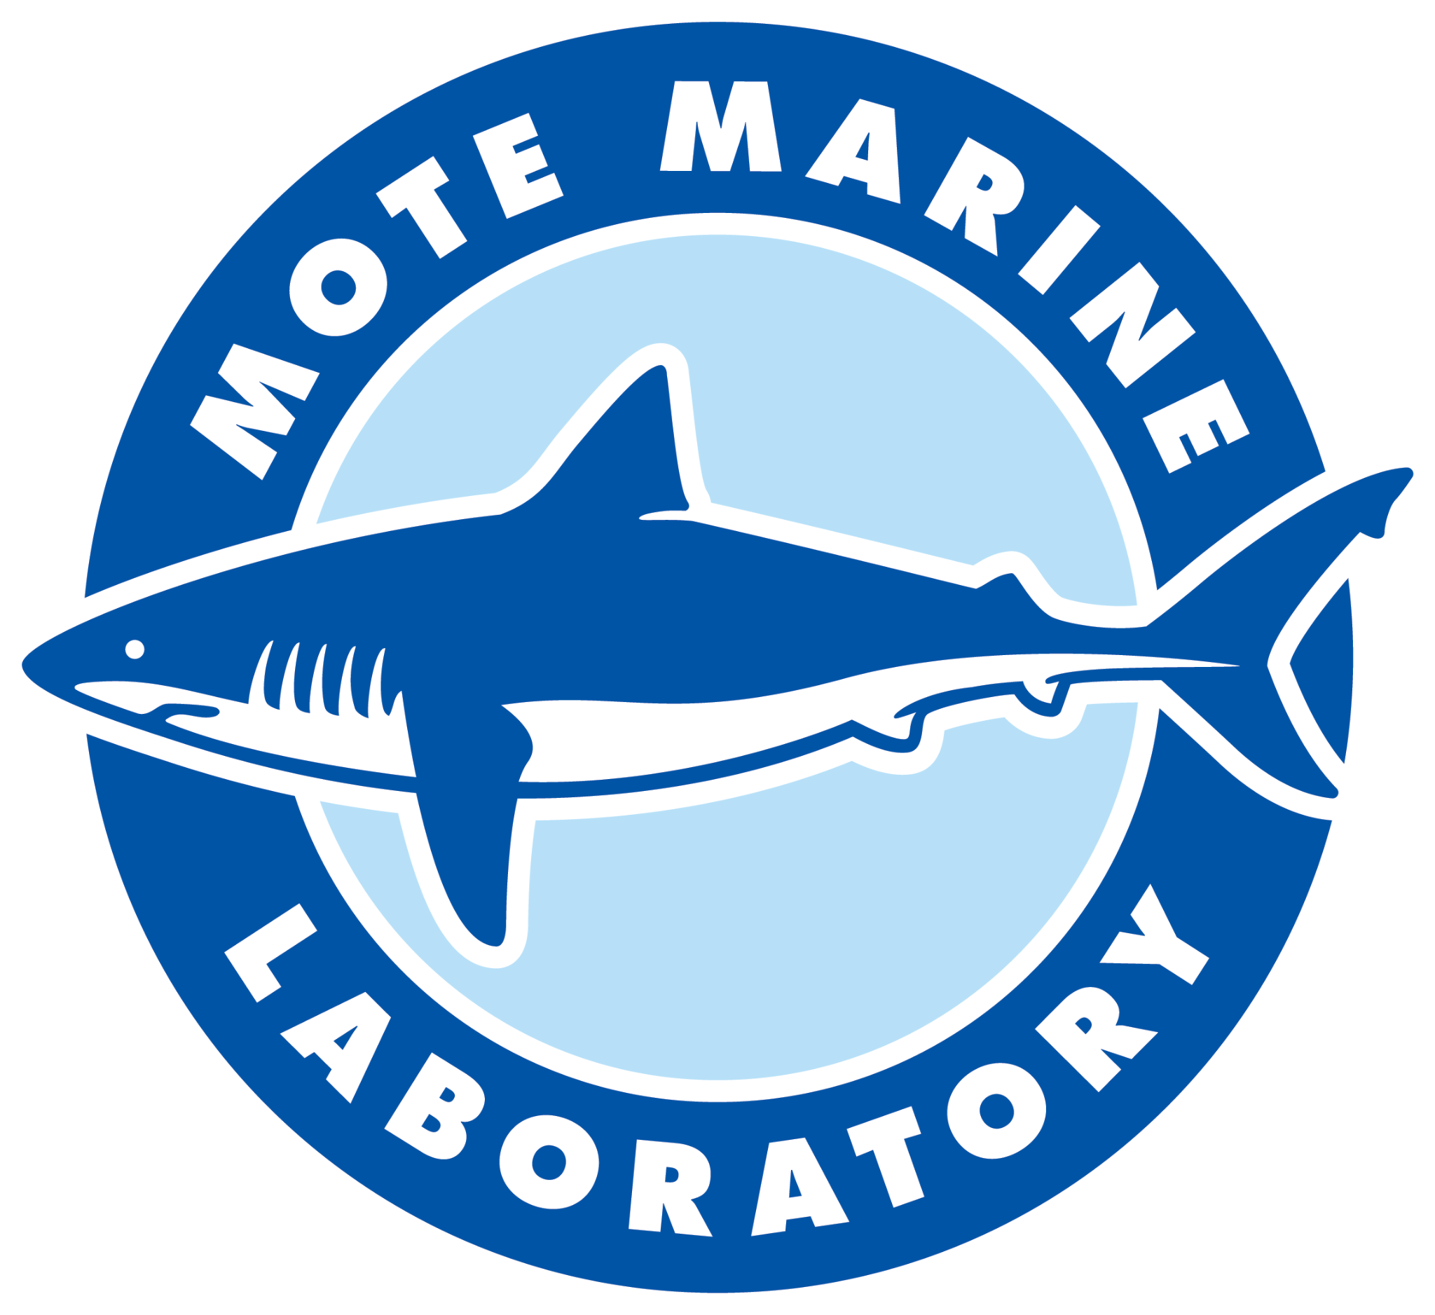
Assessment of Benthic Ecosystem Changes Post-Outplanting Using Structure-from-Motion (SfM) Photogrammetry
Authors: Ian Combs; Gabrielle D’Alonzo*; Erinn Muller; Erich Bartels; Jason Spadaro

Slide 2
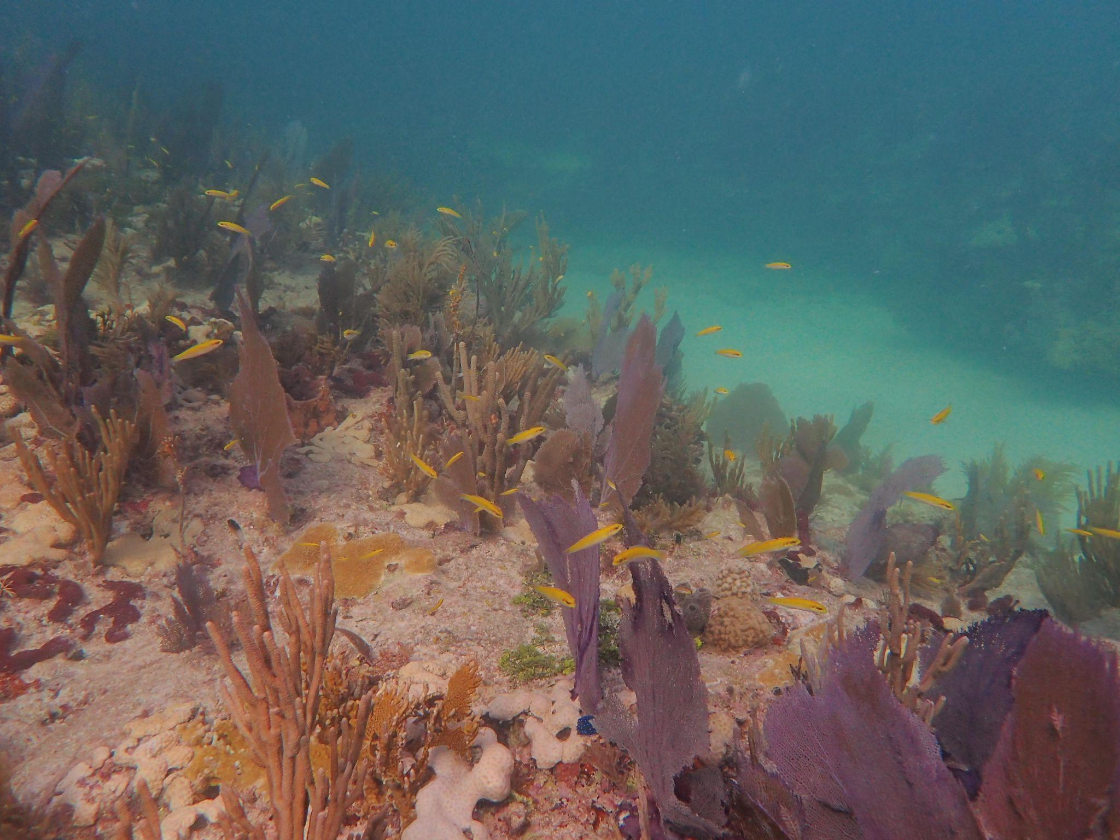
*Introduction
Numerous factors severely affecting the health and diversity of the Florida Reef Tract (FRT)
Disease
Thermal stress
Competition
Ocean acidification
Predation
Coral Restoration is a widely accepted tool used to mitigate the damage affecting the benthic community

Slide 3
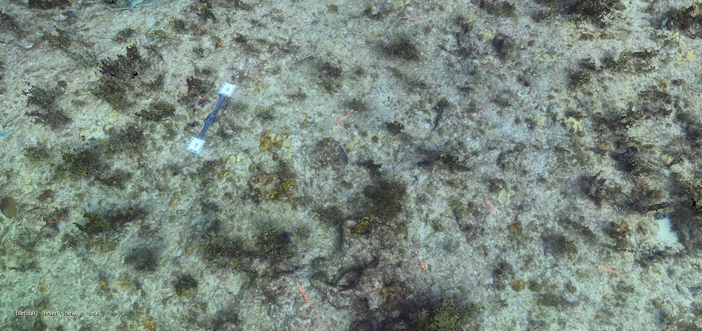
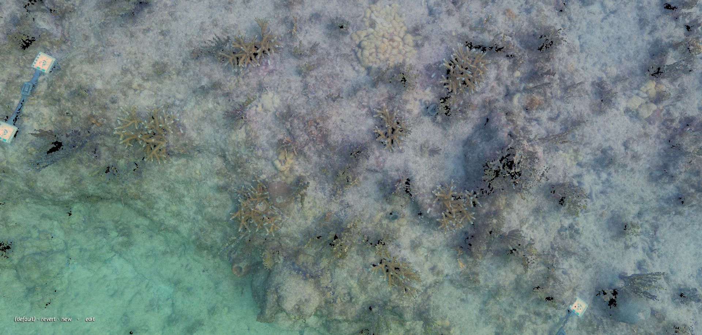
Monitoring Success
Post-restoration:
Fate-tracking via in-water surveys used to monitor success and health in the months → years after outplanting
What SfM photogrammetry can aid in:
Label loss (physically or result of overgrowth)
Percent cover & growth metrics
Whole ecosystem assessment
SfM Photogrammetry has become an increasingly popular monitoring and surveying research aid

Slide 4
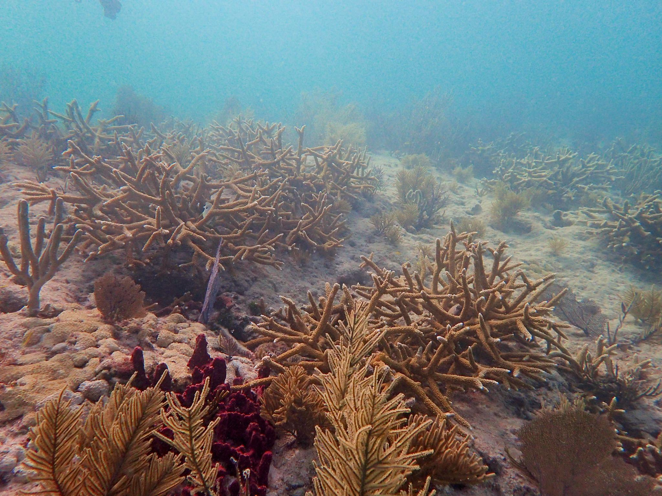
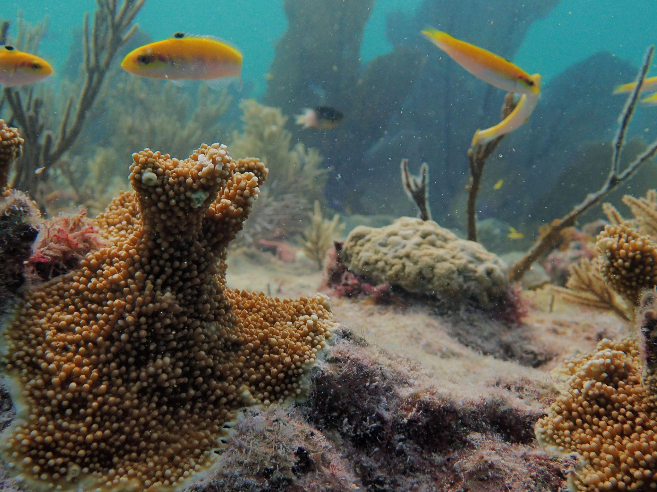
This Project
Ongoing, long-term restoration monitoring study
To date, 39(keep up, to date*) unique reef ledges
Imaged pre-restoration, and then at 12 months post-restoration
Imaging is repeated annually going forward
Depending on site, either A. cervicornis of A. palmata was species outplanted
Objectives
How is the benthic ecosystem shifting post-restoration
How can SfM Photogrammetry assist/streamline answering ecological questions
Map of sites?

Slide 5
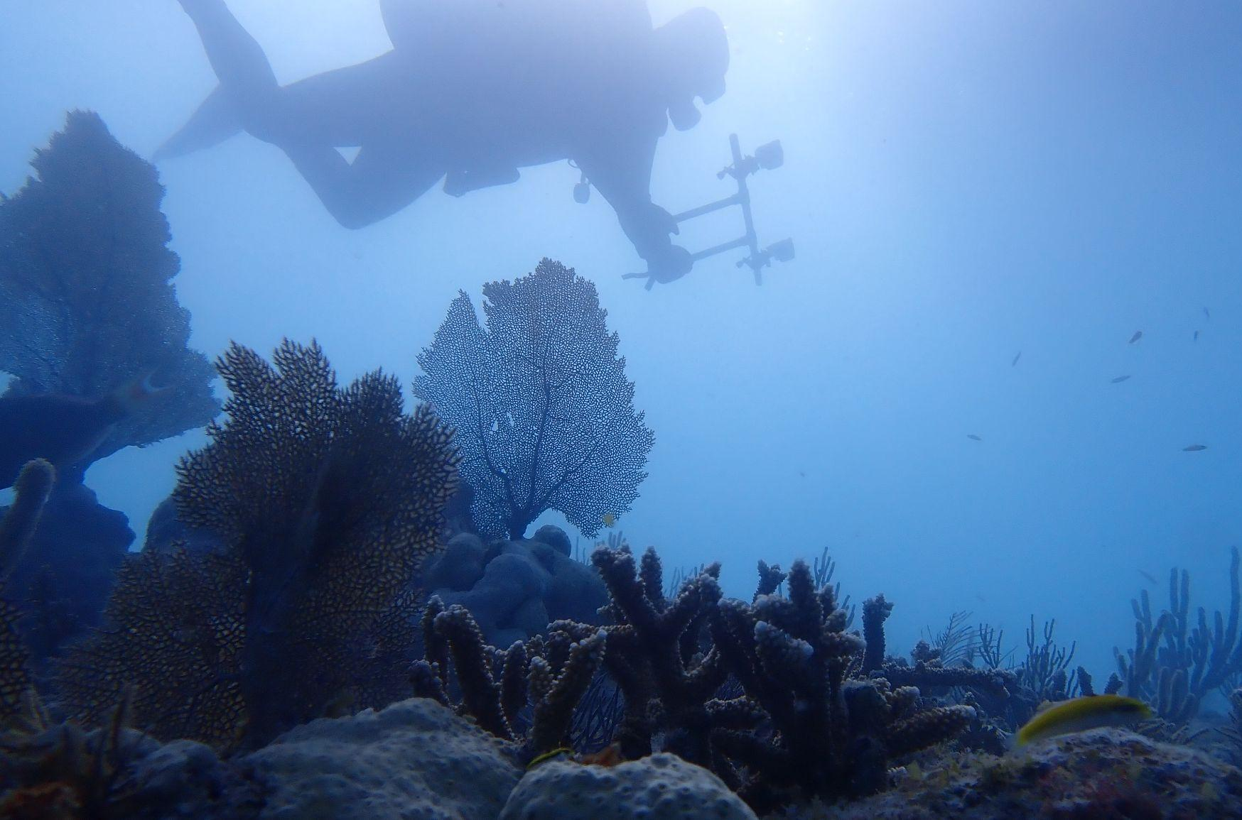
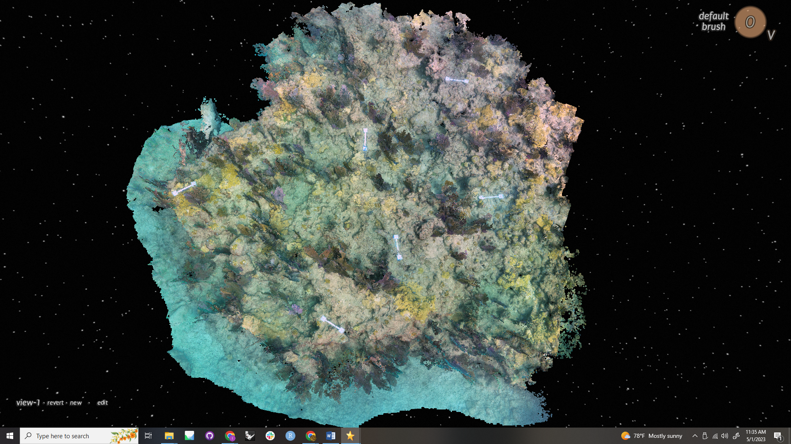
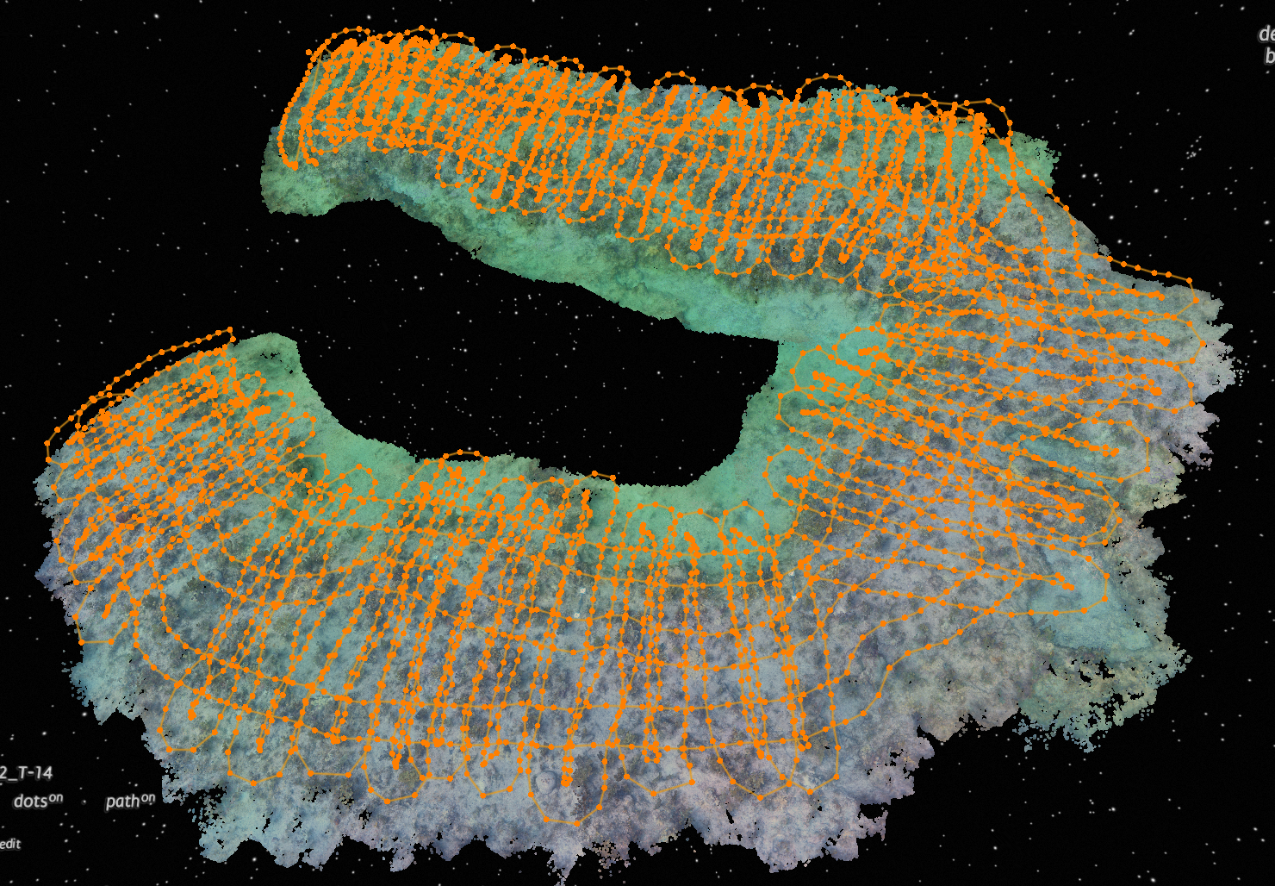
Image Acquisition
Site set-up:
Scale bars (also acting as depth markers) placed throughout site
Float markers are placed surrounding target site for orientation aid
Methods:
Photos are taken with a goal of 80% overlap
Cameras capture 1 image/second
Swim path akin to lawnmower pattern, with a few passes in the perpendicular direction
Helps reduce reprojection error
Senior Biologist Ian Combs, taken by Staff Scientist/Program Manager Erich Bartels
Cameras:
Camera rig consists of two GoPro 10s set 60cm apart on a PVC rig

Slide 6
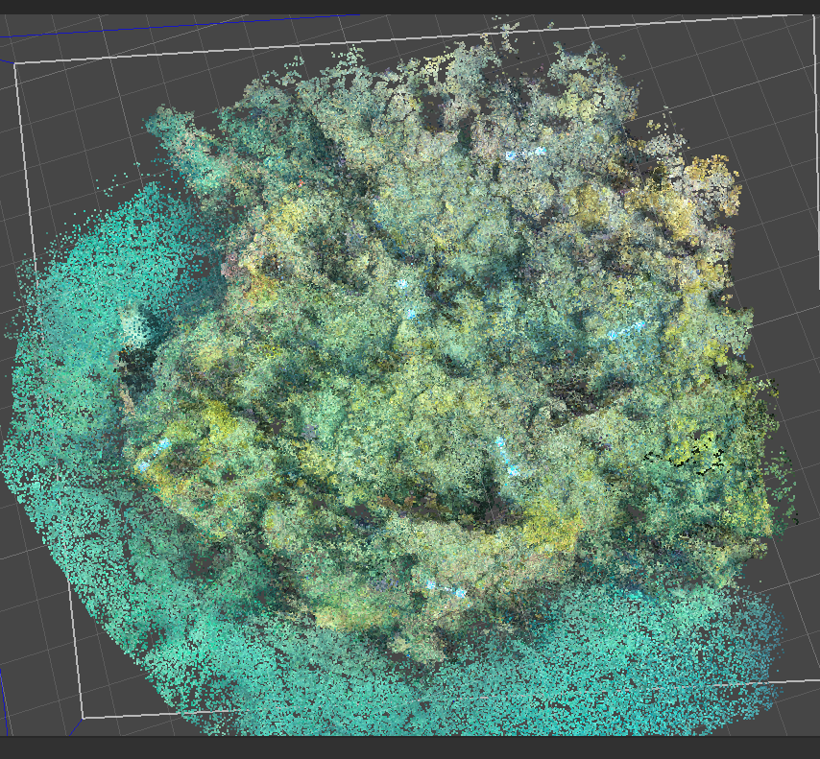
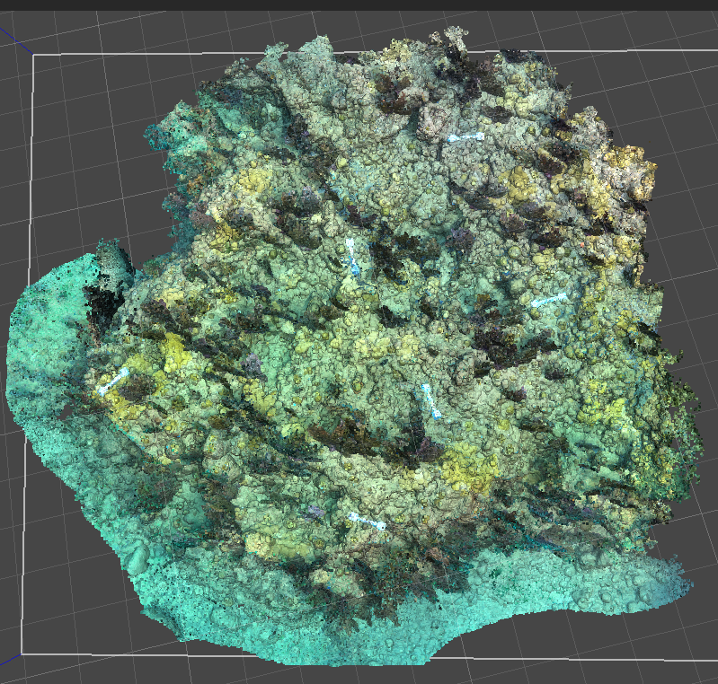
SfM Photogrammetry
Imaging technique in which three-dimensional structures are derived from sequences of two-dimensional images
Three-dimensional sparse cloud
Three-dimensional dense cloud
Orthoprojection generated in Viscore
After imagery is taken at target reef site, they are uploaded to Agisoft Metashape
Markers are detected and photos are aligned into a sparse cloud of extracted points
Dense point cloud is then generated
Imagery is used to further rectify point cloud
Software utilizes algorithm to match pixels to pre-existing points
Dense cloud can then be exported to viscore for further annotation and data extraction

Slide 7
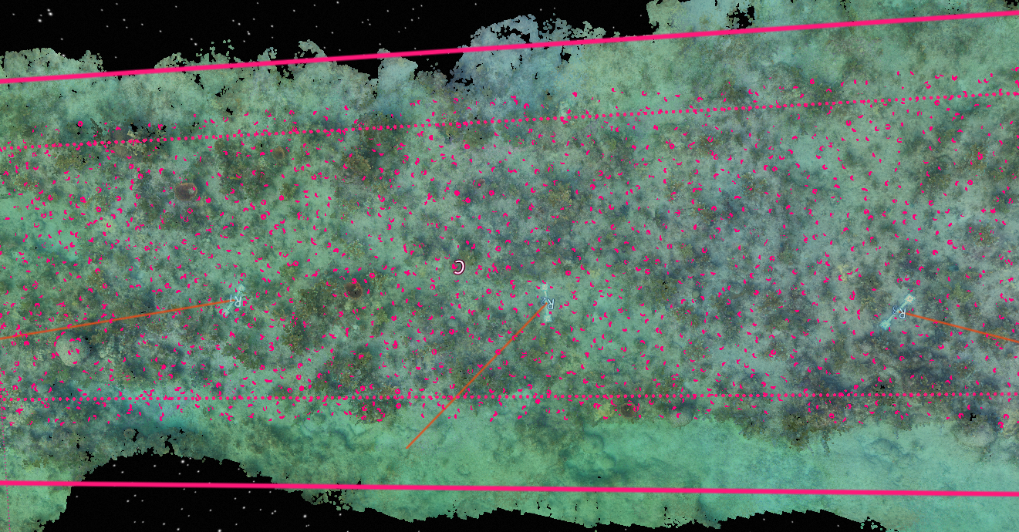
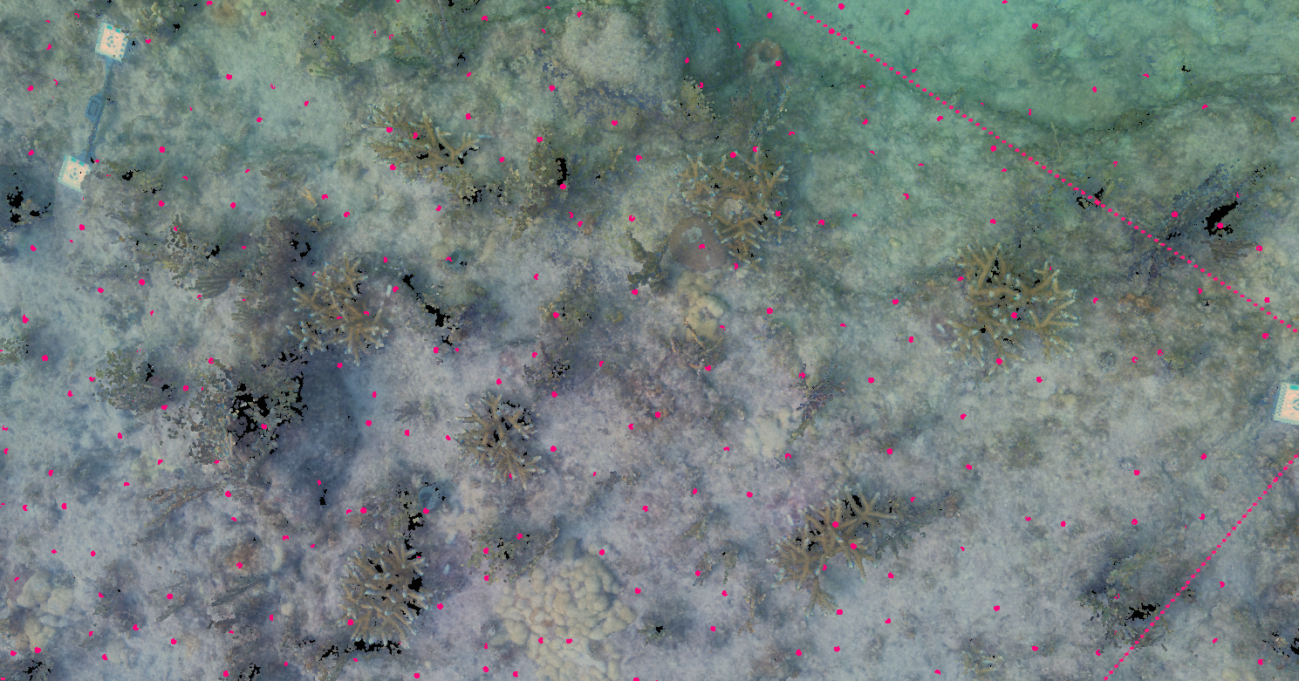
Data Collection
SfM photogrammetry allows for analysis with greater detail, without time constraints in-water
Viscore
software platform which allows for interaction with 3D visual products
Imagery is correctly scaled and oriented
Visual Point Intercept (VPI) survey; automated distribution of randomized points within specified space
Points are linked to raw imagery for identification
Determine benthic species composition

Slide 8
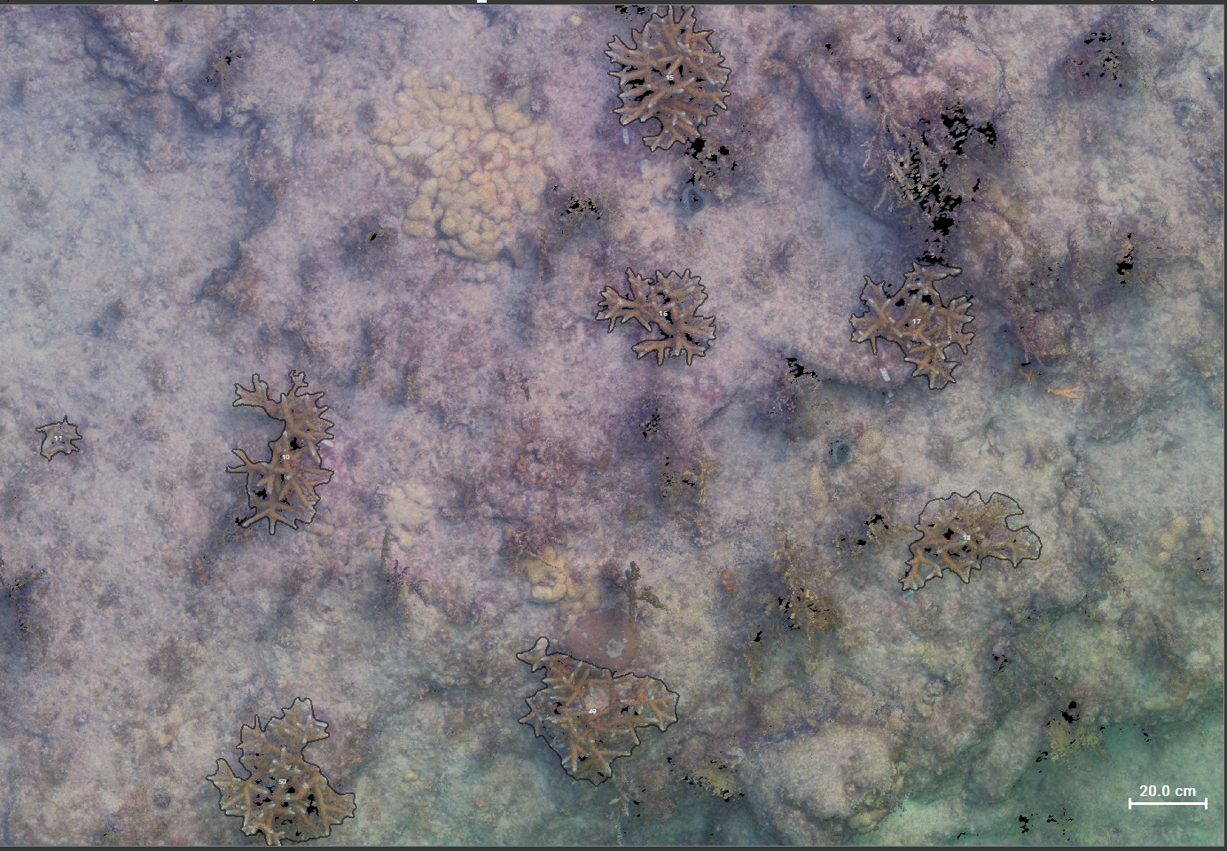
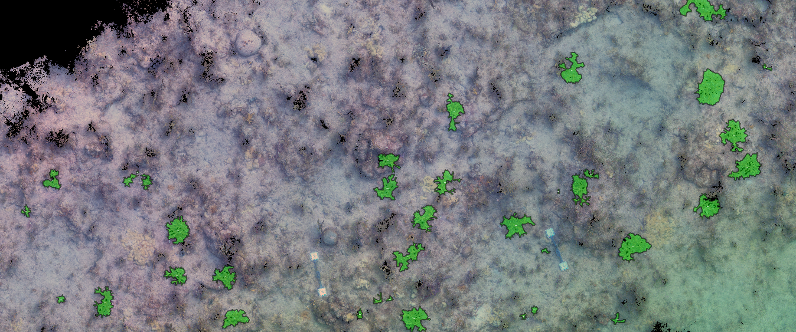
Data Collection
AI powered machine-learning capabilities help optimize data extraction
TagLab
AI-powered 2D segmentation software
Combination of semi-automatic tools along with machine-learning capabilities
Accurate representation of the distribution of 2D reef space between organisms
Automatic segmentation/classifier tool can be trained to fit different species/reef types
Both continue to keep operator “in the loop”

Slide 9
data

Slide 10
data/discussion

Slide 11
Bring it back tg

Slide 12
Acknowledgements

